Slide 1

Collections

Slide 2
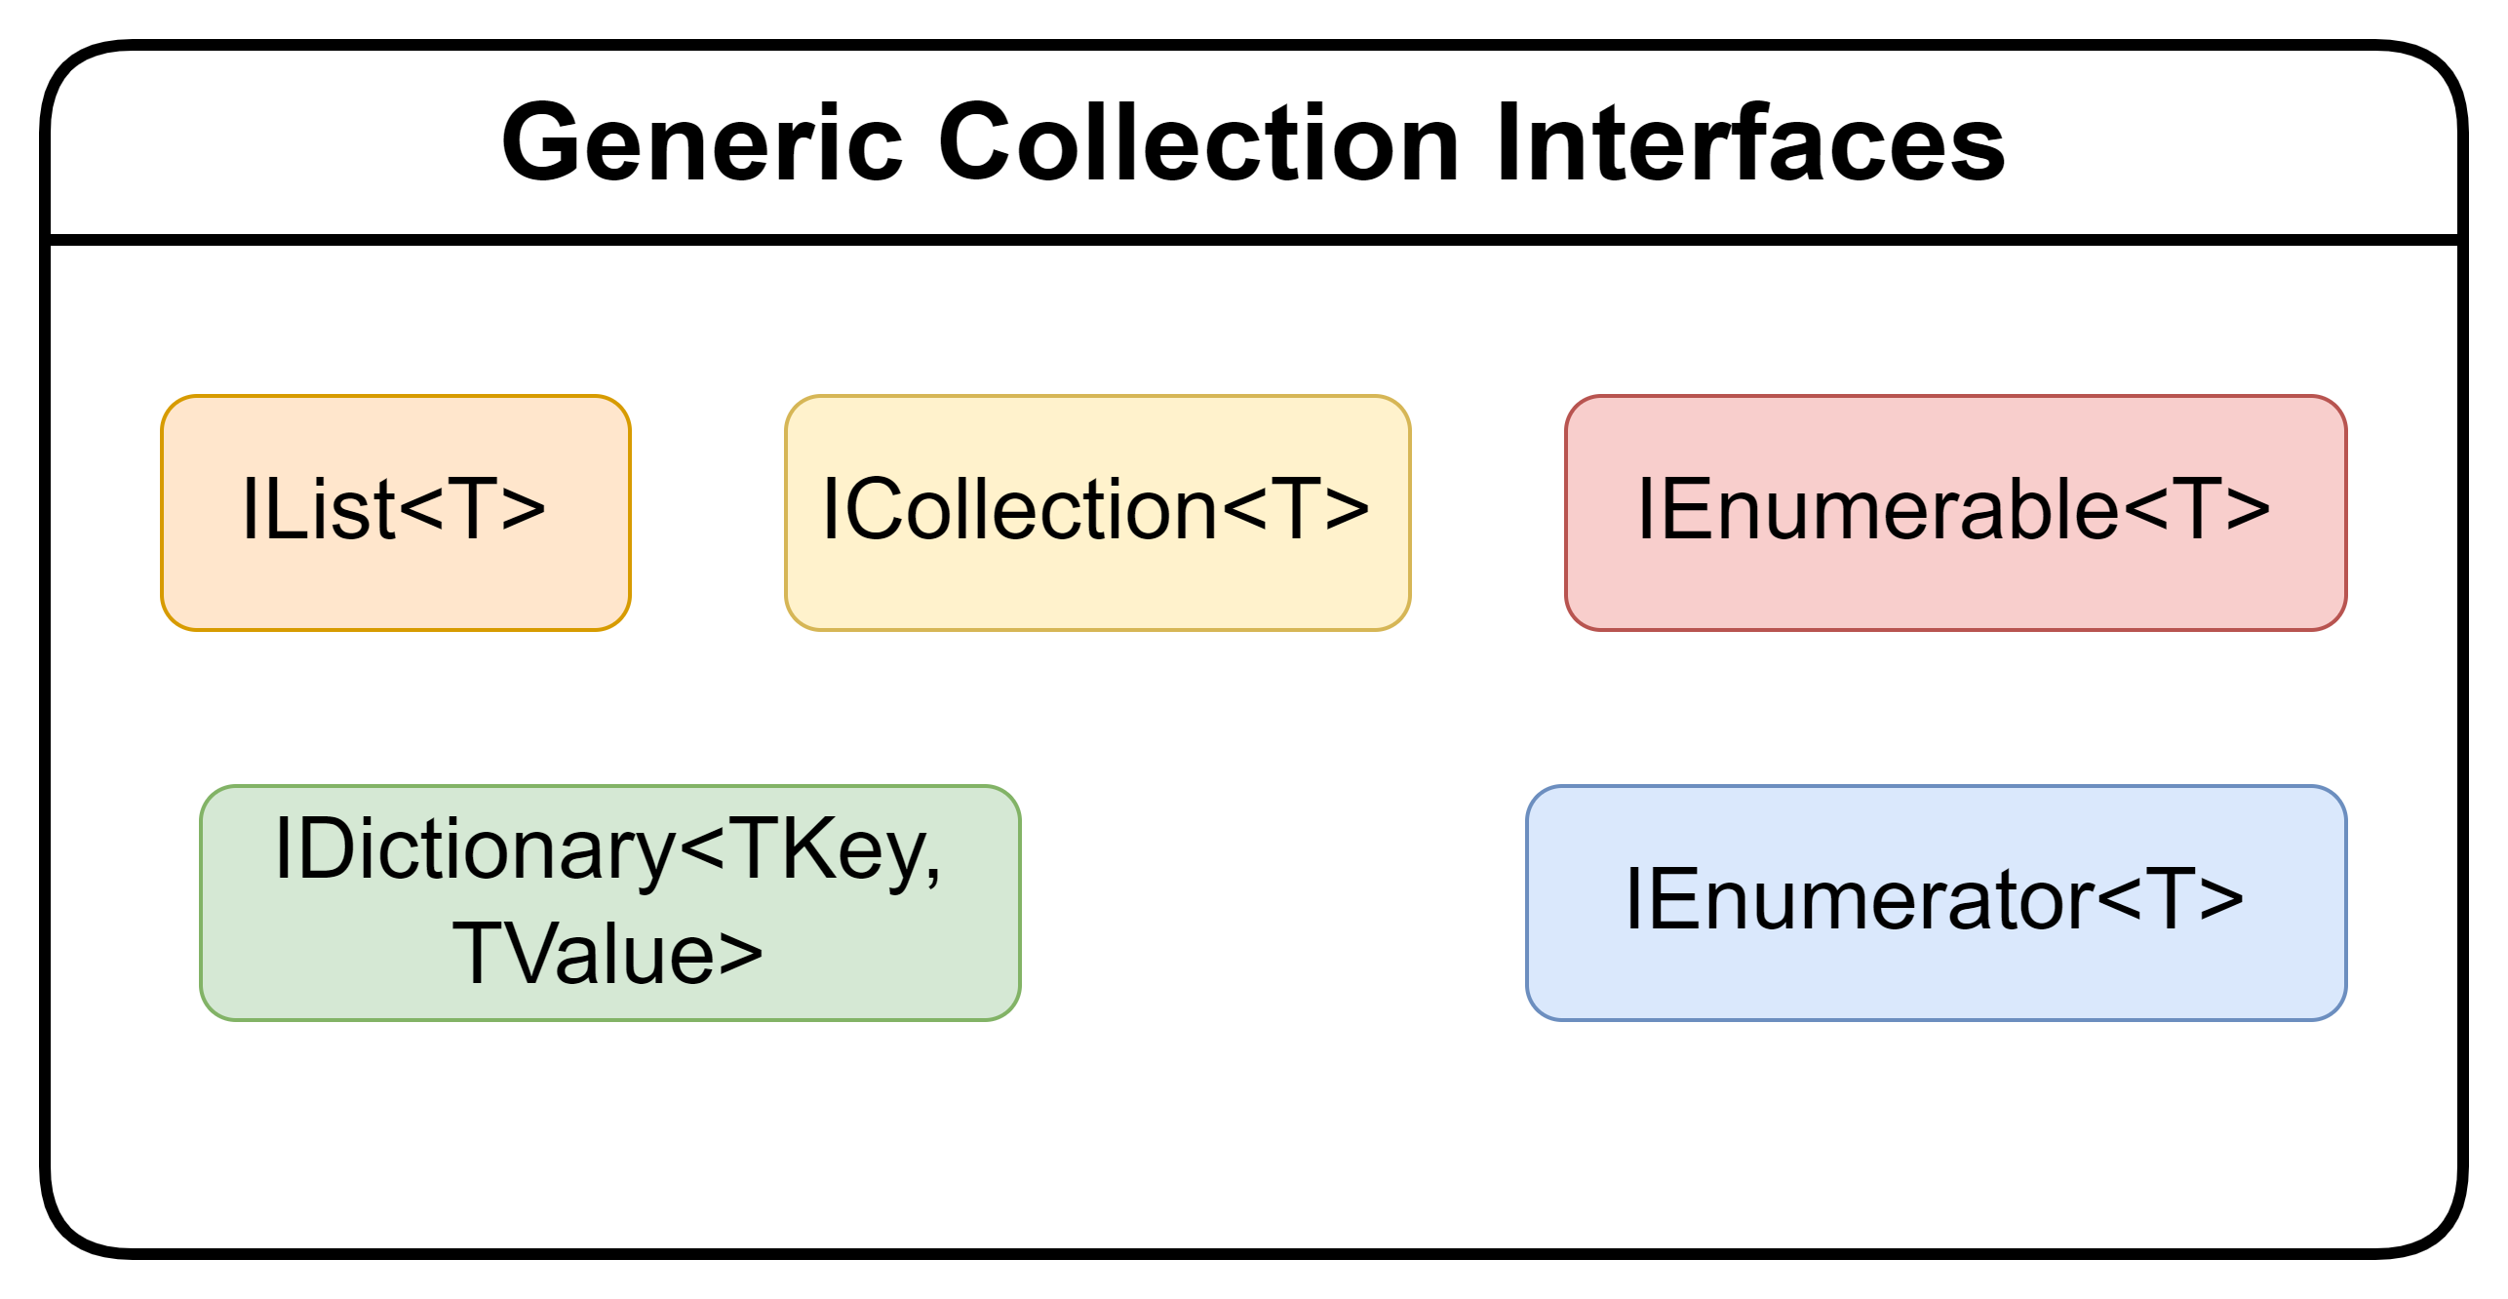

Slide 3
